Slide 1

Customer Churn Prediction & Retention Strategy
Leveraging Telco Customer Data for Strategic Insights
by Rageshree kundu

Slide 2

Core Objectives
1
Predict Churn
2
Characterize Risk
3
Recommend Strategies
Identify customers likely to leave
Define traits of at-risk customers
Develop actions to reduce churn

Slide 3
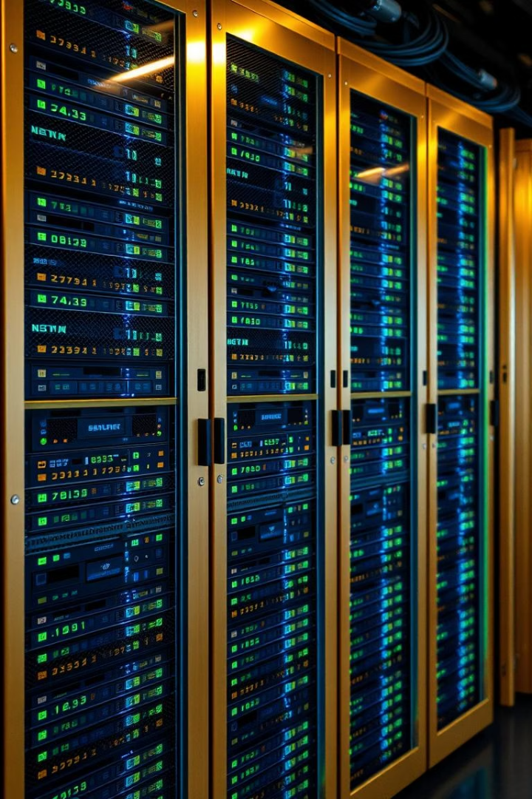
Dataset Foundation
Source
Kaggle: Telco Customer Churn
Size
~7,000 customer records
Columns
Demographics, account, usage, churn

Slide 4




Data Preparation Process
Clean Data
Remove duplicates and missing values
Encode Variables
Convert categorical features
Transform Charges
Numeric conversion for total charges

Slide 5
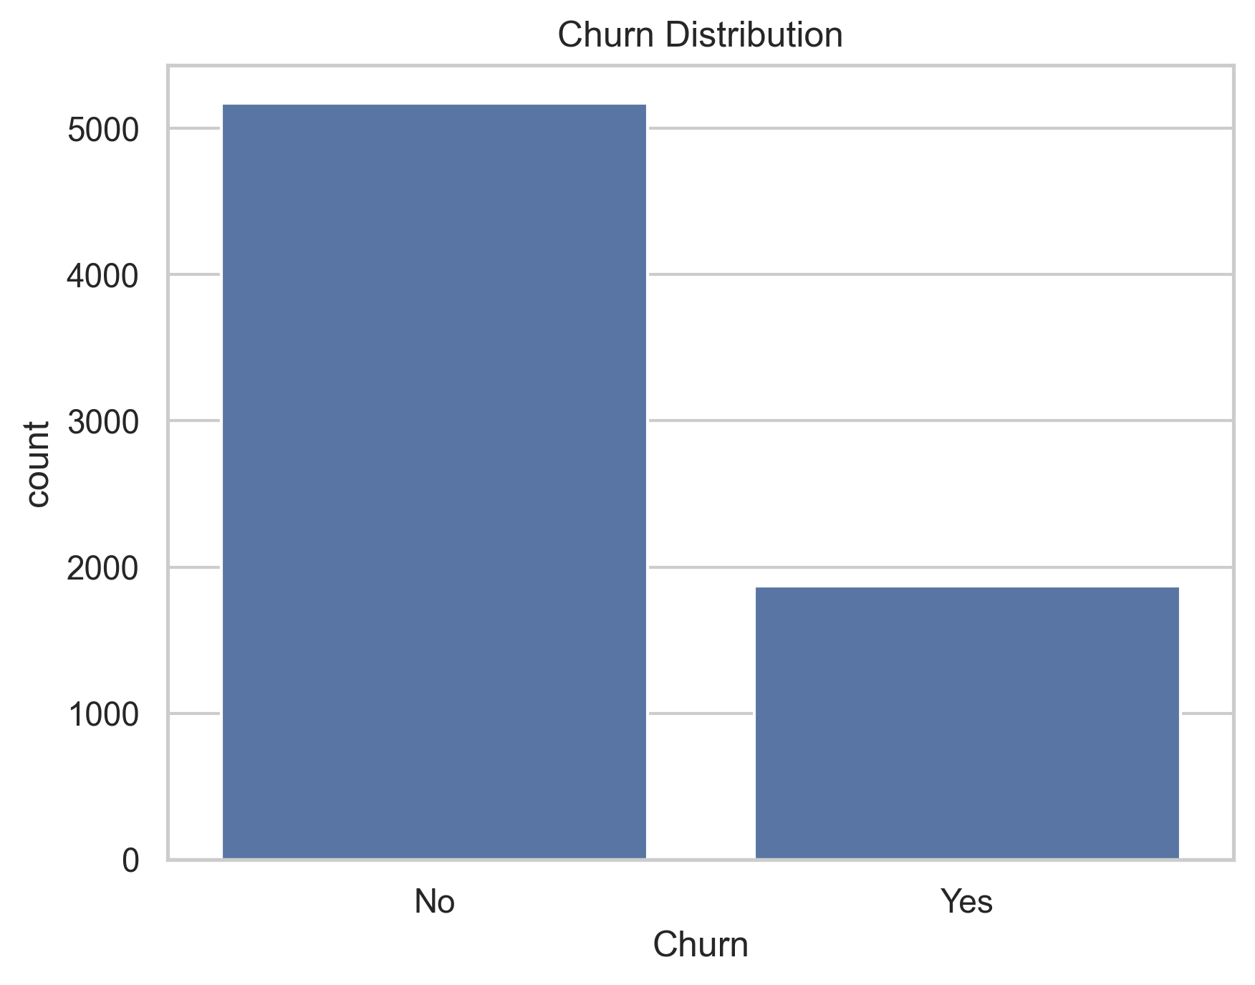
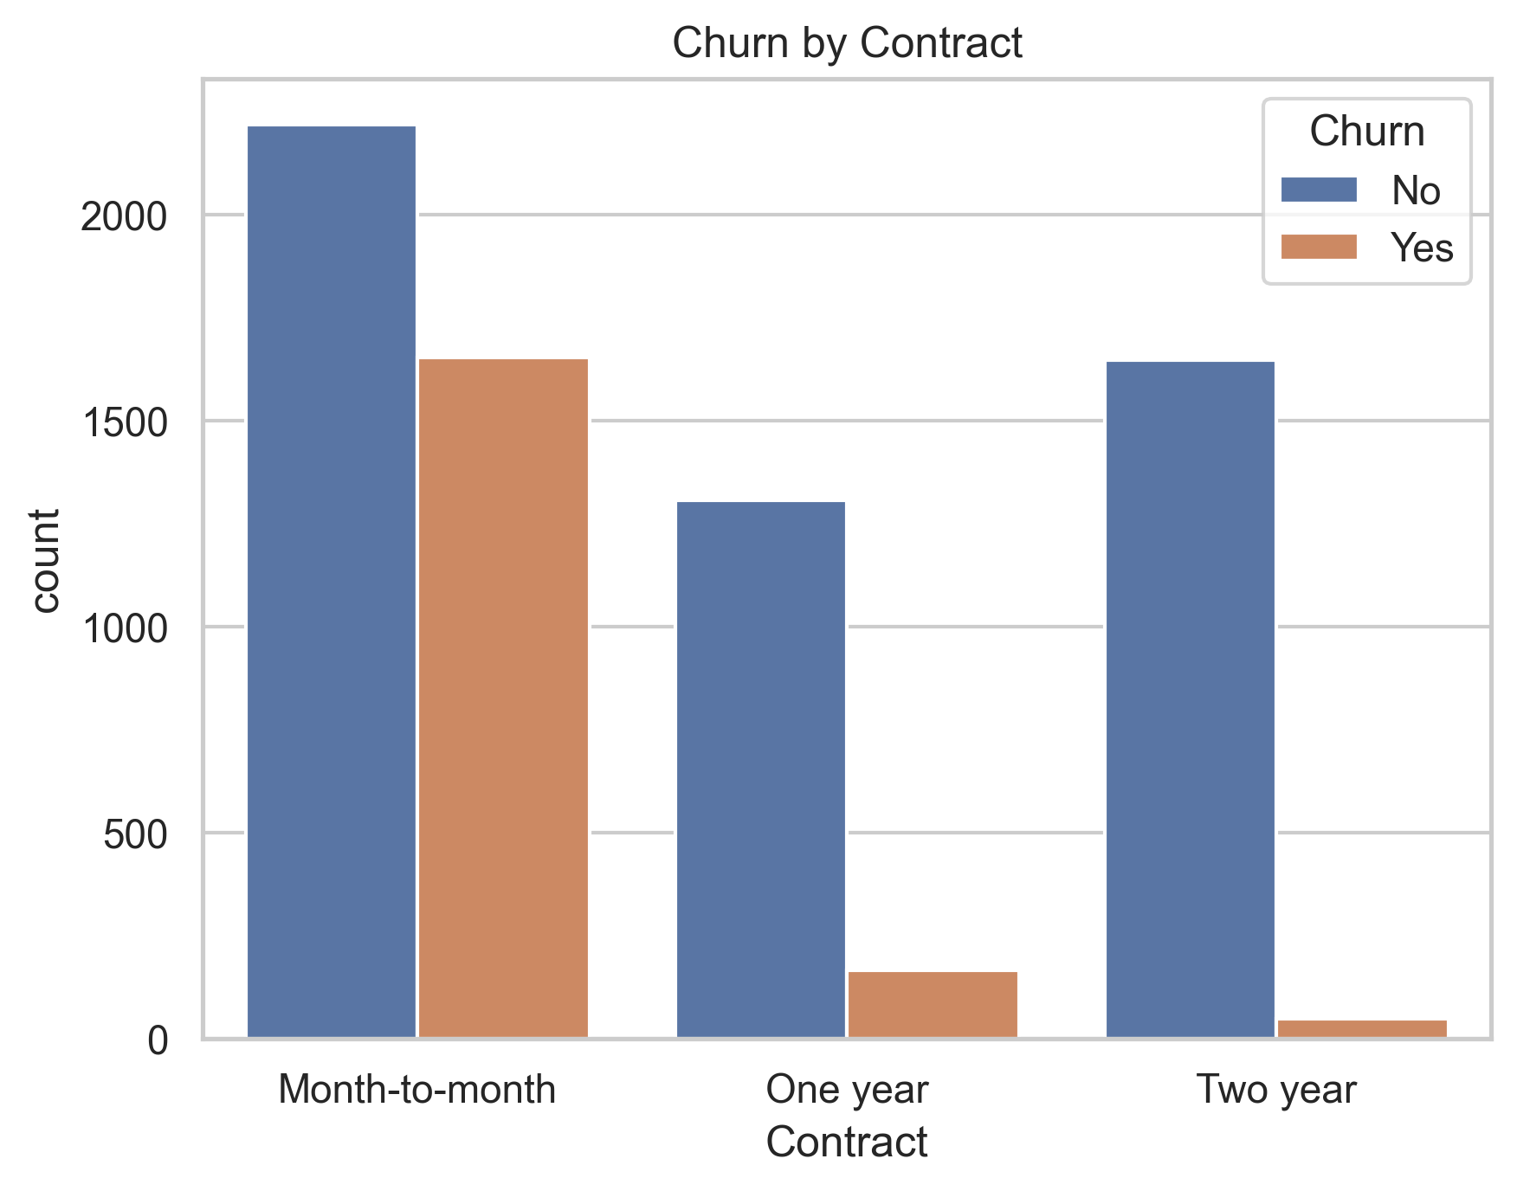
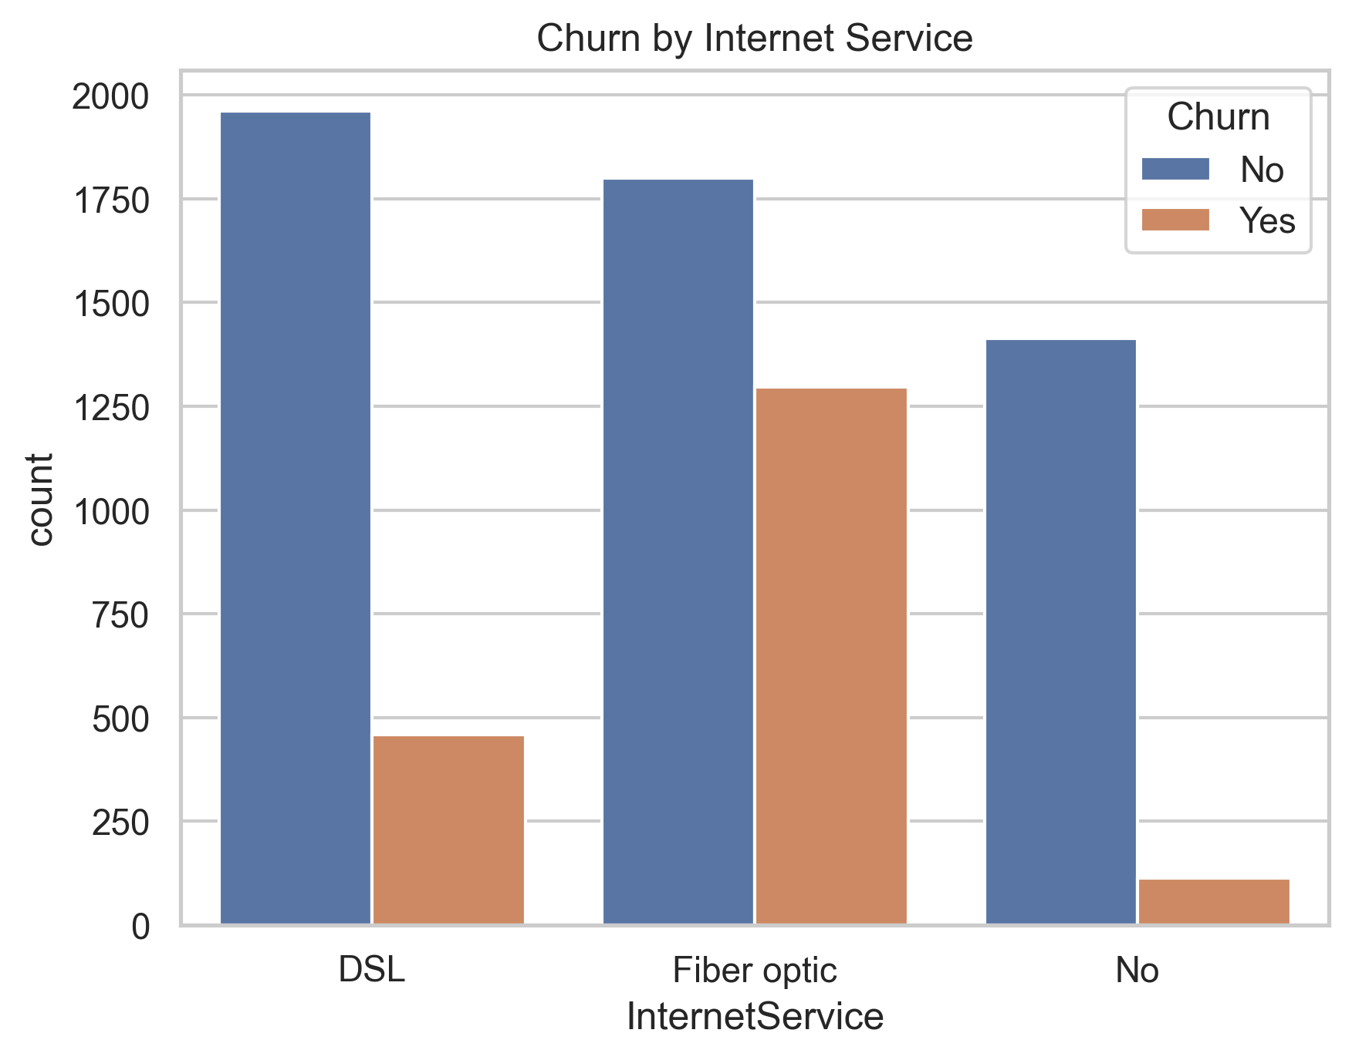
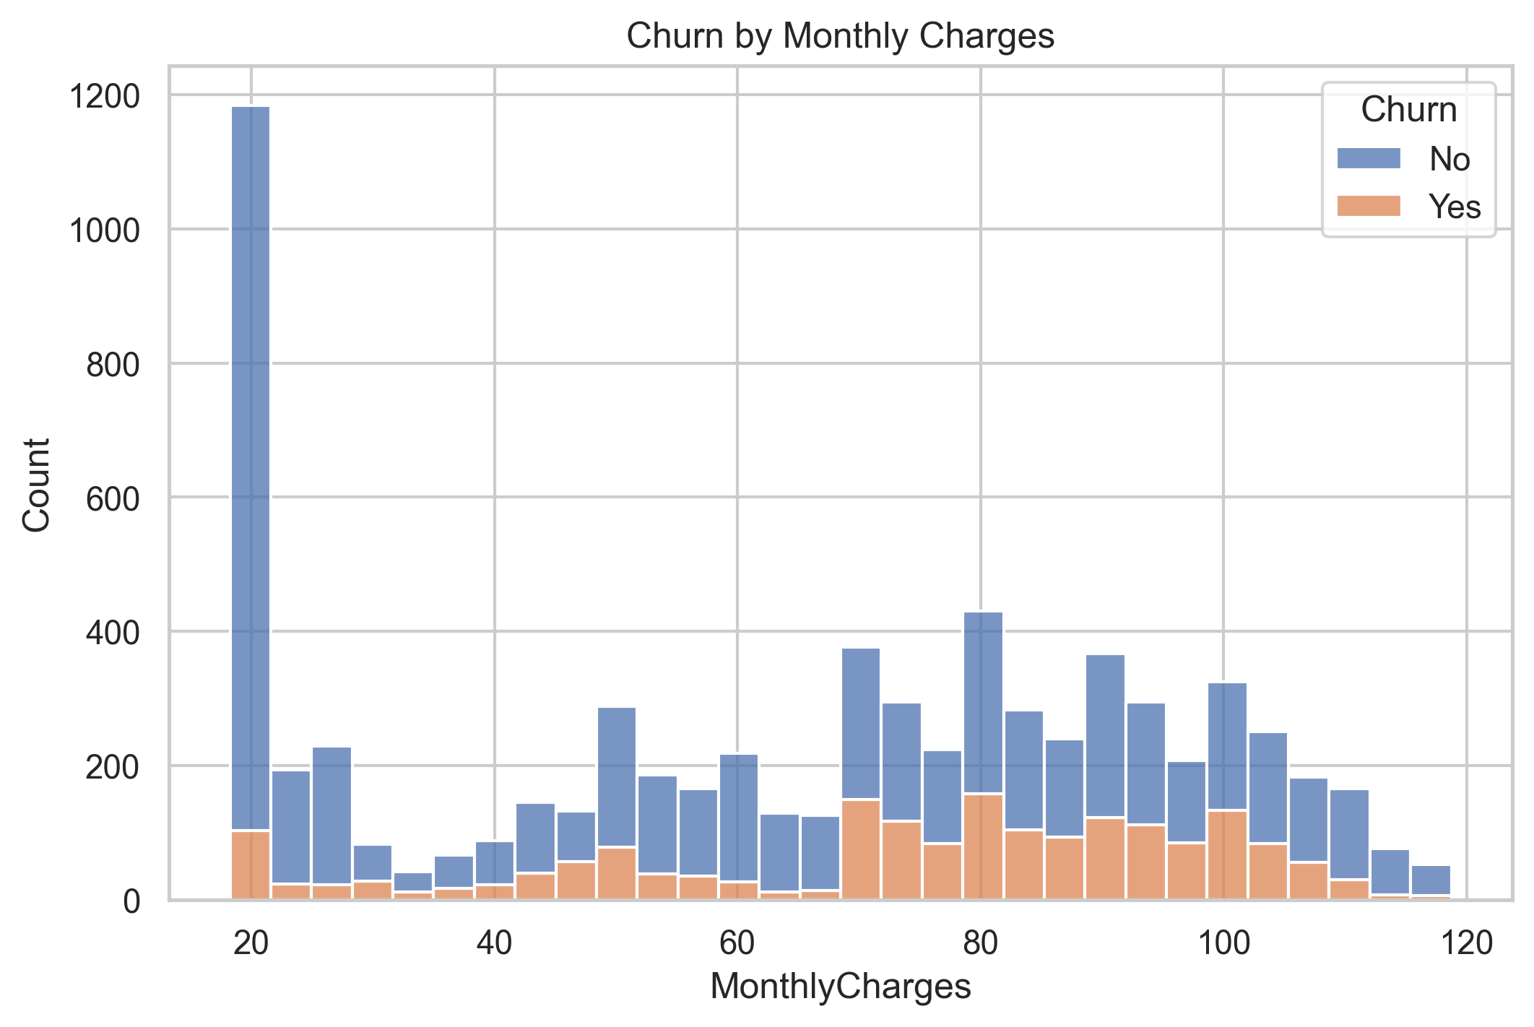
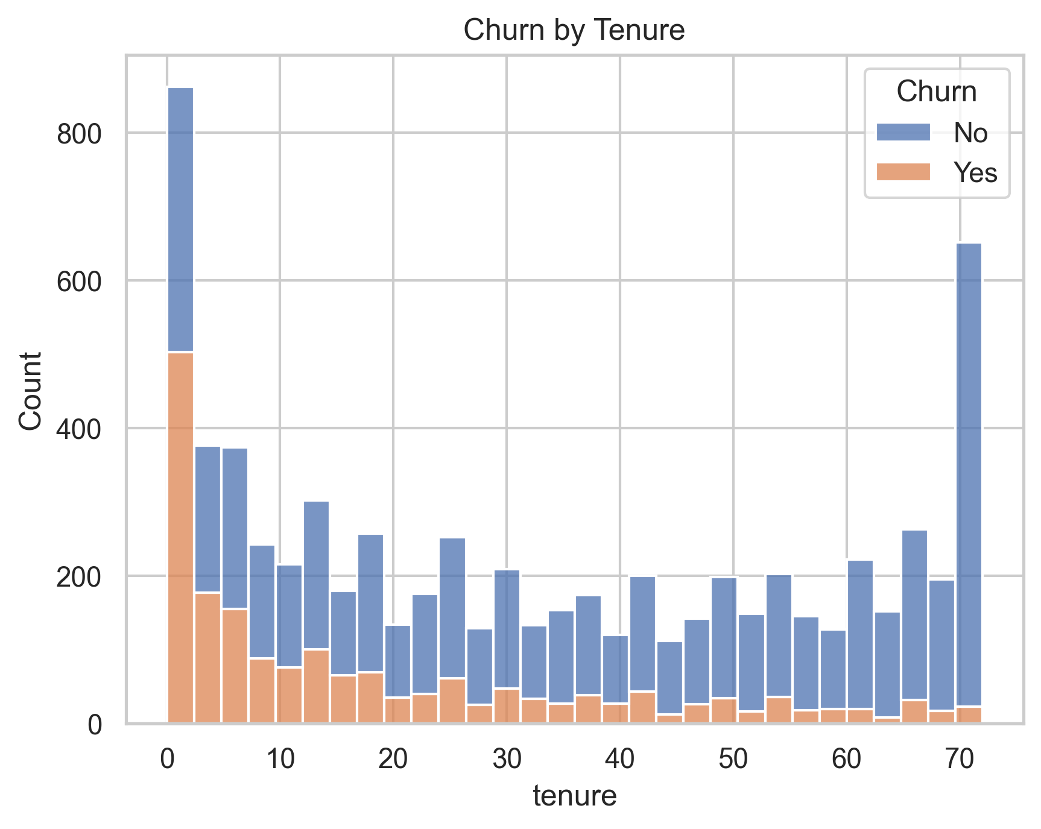
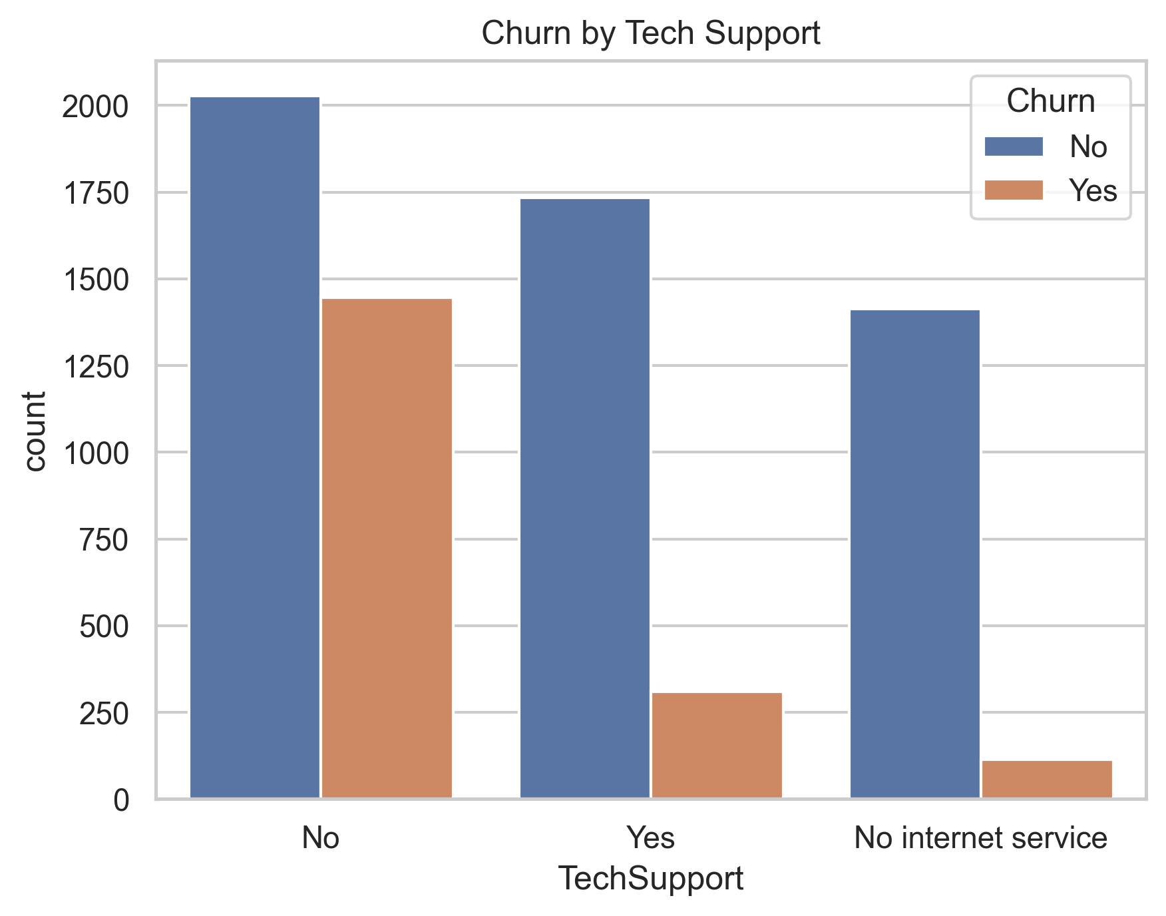
Exploratory Data Analysis (EDA)

Slide 6




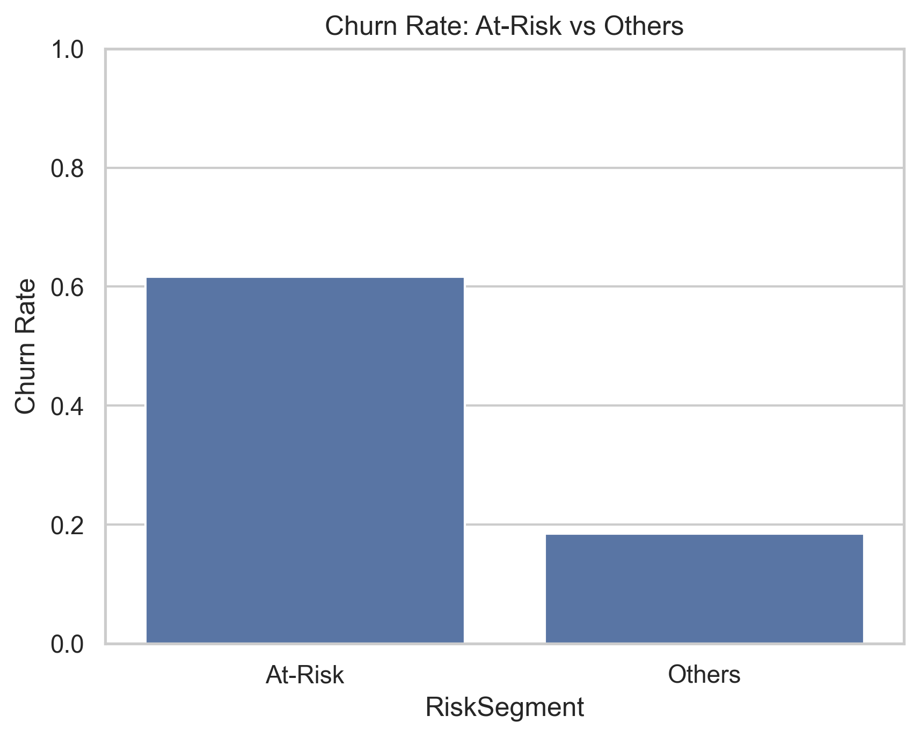
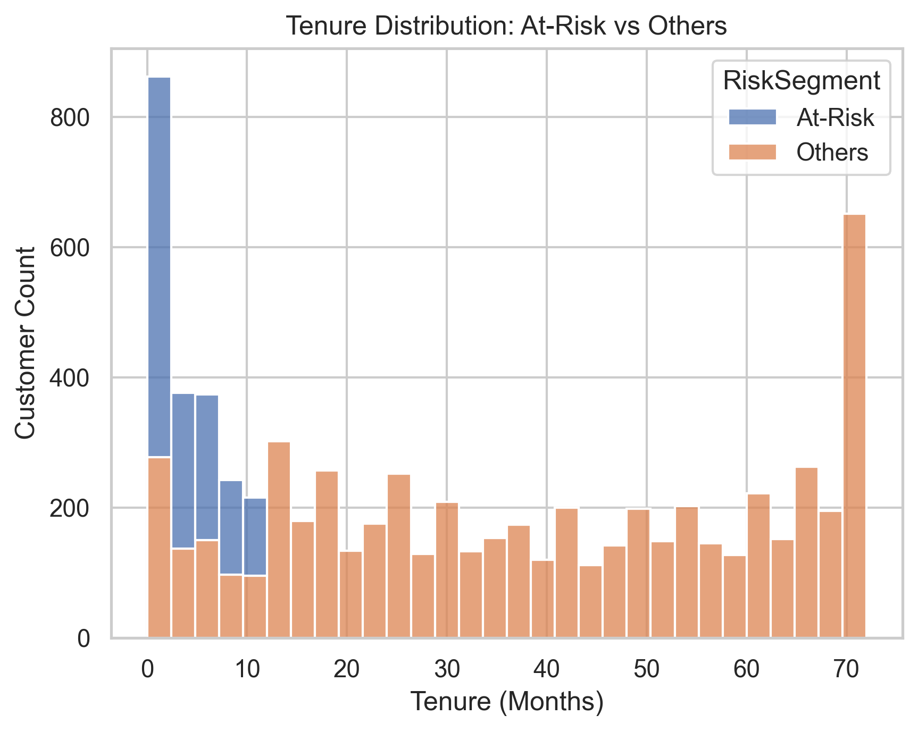
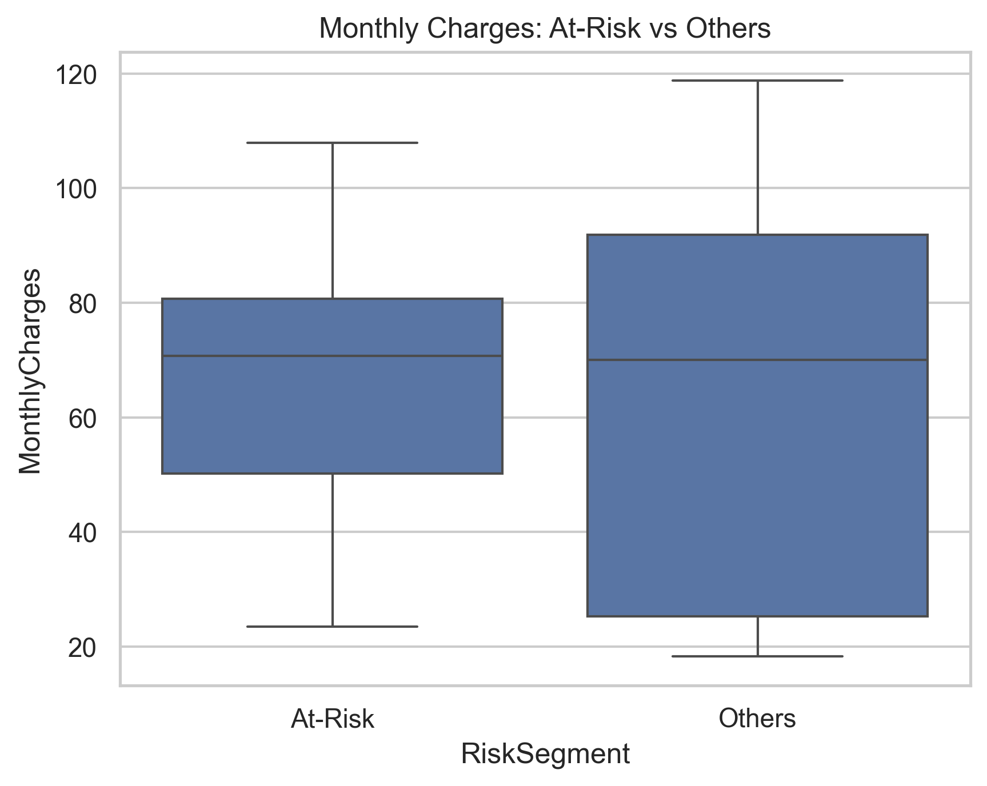

Key Churn Risk Indicators
Month-to-Month
Electronic Check
High Monthly Charges
Low Tenure
New customers more likely to churn
Higher churn
Frequent payment method for churners
Increased churn risk

Slide 7
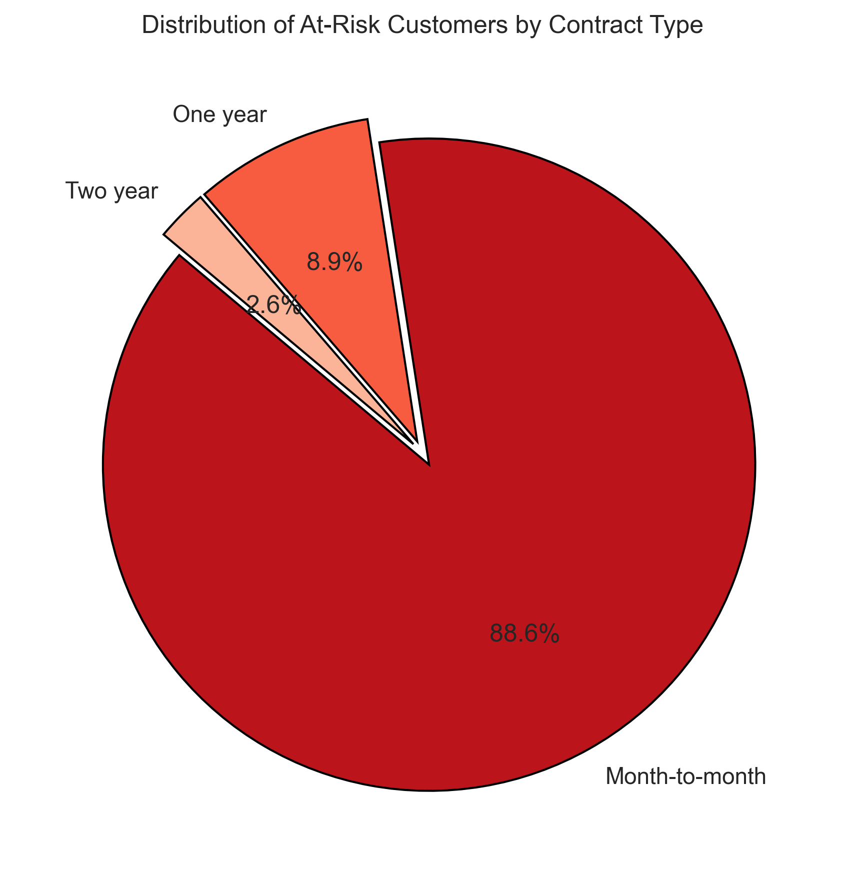
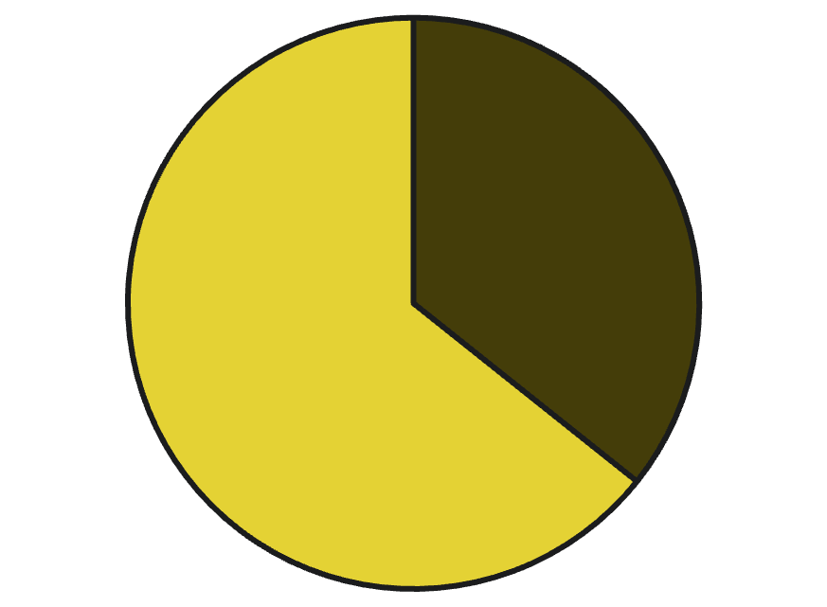
At-Risk Customer Segmentation
Using rule-based classification, we segmented customers:
At-Risk
Others
The "At-Risk" segment includes customers with tenure less than 12 months, monthly charges exceeding $70, and month-to-month contracts. This segment represents a significant portion of our customer base requiring targeted retention efforts.

Slide 8

Targeted Retention Strategies
Promote Long-Term Contracts
Offer incentives for commitment
Incentivize Auto-Pay
Encourage paperless billing
Loyalty Discounts
Reward low-tenure users
Personalized CRM Offers
Tailor offers to individual needs

Slide 9



Business Impact
Reduced Churn
Increased LTV
Enhanced Experience
Expect 10-15% less customer attrition. Save valuable relationships.
Boost customer lifetime value significantly. Drive sustainable revenue.
Improve customer satisfaction. Build stronger brand loyalty.

Slide 10



Conclusion
Key Findings
Actionable Insights
Future Work
We identified the primary indicators driving customer churn, such as contract type and tenure.
Our analysis provides practical strategies to reduce churn and retain valuable customers.
Next steps include deploying ML models and analyzing customer lifetime value for sustained growth.

